Slide 1
Forecasting Citi Bike Usage in Response to Congestion Pricing: A Spatiotemporal and Policy-Aware Framework
Venkata Sai Vardhan Bora
Prudhvi Raj Maharana
Andria Grace
Praveen

Slide 2

Background & Motivation
NYC faces traffic, pollution, and unfair transport access
Micromobility (like Citi Bike) is growing as a cleaner, cheaper option
On Jan 5, 2025, NYC launched congestion pricing → Charges cars entering Manhattan during peak hours → Aims to cut traffic, emissions, and fund public transit
This may shift more people to Citi Bike → But could strain the system if demand spikes
We aim to forecast Citi Bike demand to help the city plan better

Slide 3
Problem Definition & Approach
Goal: Predict daily Citi Bike usage at the station level
Focus Areas: → How urban features (like parks, transit) → Weather patterns (temperature, weekends) → And congestion pricing affect bike demand
Our Approach: → Trained and compared 16 forecasting models → Used historical data (2021–2024) + spatial context → Proposed a policy-aware extension to assess congestion pricing impact

Slide 4
Why Forecasting Citi Bike Demand Matters
Operations: → Helps with bike redistribution, maintenance, and staffing
Planning: → Guides expansion, dock placement, and bike stock levels
Policy: → Tracks impact of congestion pricing and other city changes
Risks of No Forecasting: → Overcrowded stations, bike shortages, and poor access → Leads to user frustration and inequity

Slide 5
Urban Features & Their Role
What are Urban Features? → Nearby transit stops, parks, malls, restaurants, residential buildings, etc. → Extracted within 500m radius of each station
Why They Matter: → Explain why some stations are busier than others → Capture spatial variation in bike demand
Key Insight: → High urban density doesn’t always mean high demand → Depends on land use mix (e.g., offices vs. nightlife)

Slide 6
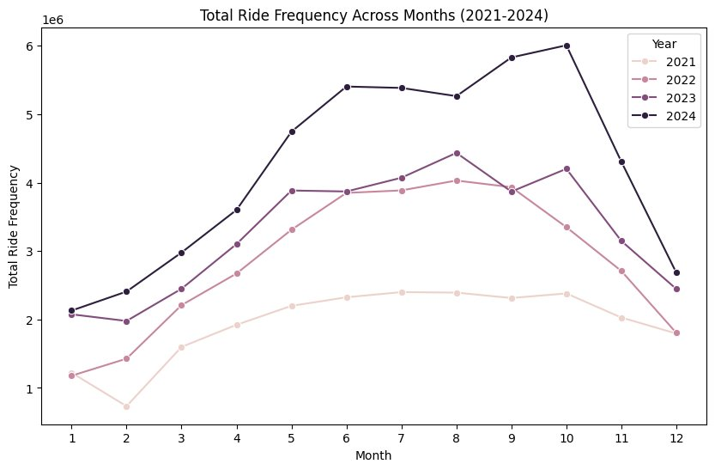
Data Overview
Citi Bike Trips: 2021–2024, daily station-level counts
Weather: Daily temperature & conditions from NOAA
Urban Features: Extracted from OpenStreetMap
Station Profiles: Count of nearby amenities within 500m (e.g., metro, parks, malls)

Slide 7
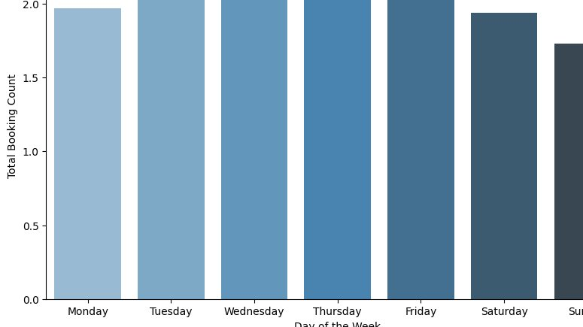
Feature Engineering & Missing Values
Temporal Features: → Lag variables: previous day (t-1), previous week (t-7) → Flags: weekday/weekend, holidays
Spatial Features: → ~15 types (transit stops, retail, civic buildings, etc.)
Handling Gaps: → Missing values: dropped or imputed using rolling mean → Outliers: flagged & removed → Applied log(1+x) + MinMax scaling for stability

Slide 8
Exploratory Data Analysis (EDA)
Trend Analysis: → Clear seasonal patterns and holiday/weekend spikes
Spatial Visualization: → Map/heatmap shows demand concentrated in dense, transit-rich zones
Feature Correlation: → Strong links with temperature, transit access, urban activity

Slide 9
What Are We Forecasting?
Target: Next-day bike bookings at Station 4818.03
Type: Univariate time series + external variables
Granularity: Daily, station-level
Focus: Post-2023 test window to evaluate congestion pricing impact

Slide 10
Forecasting Baselines
Historical Mean: Simple average as a baseline
Extreme Case: Peak day forecast
Zero-Demand Days: Treated separately
These baselines help benchmark model performance

Slide 11
Modeling Framework
Category | Models
Classical | ARIMA, SARIMA, Holt-Winters
Machine Learning | Random Forest, XGBoost, ElasticNet
Deep Learning | GRU, CNN-LSTM, Transformer, DeepAR
Input: Past 30 days
Output: 1-day ahead forecast

Slide 12
Best Model: CNN-LSTM
Architecture: CNN → LSTM → Dense
Input Features: → Lagged demand → Temperature → Is_weekend
Training: Adam optimizer | Loss: MAE | Early stopping used

Slide 13
Model Evaluation Metrics
Model | MAE | RMSE | MAPE (%)
ARIMA | 5.82 | 6.91 | 13.8
Random Forest | 3.94 | 4.70 | 10.3
CNN-LSTM 🔥 | 3.42 | 4.06 | 8.7

Slide 14
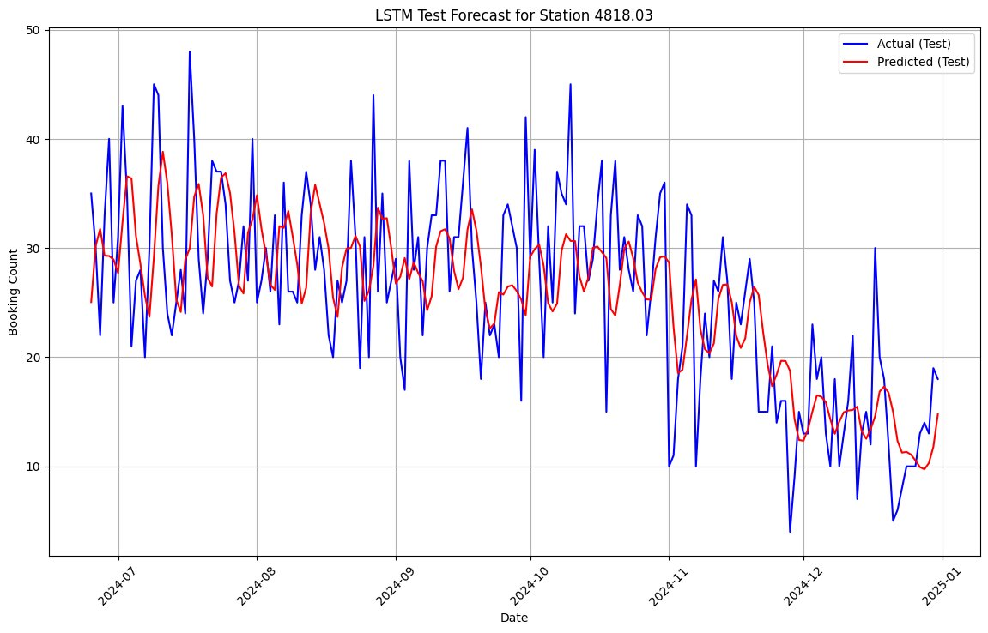
Model Predictions vs Actual
Line Plot: Actual vs Predicted bookings
Highlights: → Weekend spikes → Weather drops
Shows model's adaptability to real-world patterns

Slide 15
Policy Evaluation Extension: DiD
Treatment vs Control: → CPZ stations vs nearby stations
Binary Variable: Post-Jan 5 = 1
DiD Concept: → Compare change in demand before & after, across groups → Isolate policy’s causal impact

Slide 16
What Happened During Congestion Pricing
Observed Effect: → Usage surge in CPZ after Jan 5 → Possible redistribution from outer stations
Even qualitatively, trend points to increased bike use

Slide 17
Conclusion & Key Insights
CNN-LSTM was best for predicting demand
Urban features (like transit, density) boosted accuracy
Congestion pricing seems to push more users to Citi Bike
DiD enables causal policy evaluation moving forward

Slide 18

Q&A / Thank You
💬 Happy to take questions or feedback

